Slide 1

Data 603 – Big Data Platforms
Lecture 3
MapReduce & Cloud Computing

Slide 2
What we will cover today
MapReduce
MapReduce Demo
Cloud Computing
Cloud Computing Demo

Slide 3
MapReduce

Slide 4
MapReduce Definition 1
“Hadoop MapReduce is a software framework for easily writing applications which process vast amounts of data (multi-terabyte data-sets) in-parallel on large clusters (thousands of nodes) of commodity hardware in a reliable, fault-tolerant manner.”
Source: https://hadoop.apache.org/docs/current/hadoop-mapreduce-client/hadoop-mapreduce-client-core/MapReduceTutorial.html

Slide 5
MapReduce Definition 2
“MapReduce is a computing model that decomposes large data manipulation jobs into individual tasks that can be executed in parallel across a cluster of servers. The results of the tasks can be joined together to compute the final results.”
Source: https://www.oreilly.com/library/view/programming-hive/9781449326944/ch01.html

Slide 6
MapReduce in a Nutshell
MapReduce is a programming model for processing large data sets and generating results developed at Google.
Runs on a large cluster of commodity hardware and is highly scalable
Processes many terabytes of data on thousands of machines
Uses the Manager-Worker model
Widely used on distributed and loosely coupled systems

Slide 7
MapReduce
The goal: Abstracting away the complexity of parallel computing from the users
Easy utilization of distributed parallel computing
… but HOW?

Slide 8
MapReduce
The run time (e.g. Hadoop) takes care of
The details of the partitioning of input data
Scheduling the program’s execution across nodes
Managing inter-node communications
Handling of node failures
You only need to focus on the code logic!

Slide 9
MapReduce
MapReduce = Map + Reduce
Map:
Accepts key/value pair
Emits intermediate key/value pair
Reduce :
Accepts intermediate key/value pair
Emits output key/value pair
We will review some examples of the MapReduce application

Slide 10
MapReduce
Processing is broken into two phases: Mapping phase followed by the reduce phase
For each phase a key-value pair is passed as the input
Each phase returns a key-value pair
The types of key and value can be chosen by the programmer

Slide 11
Map Phase
Map phase is done by mappers
Mappers take unsorted key/value pairs
Mapper returns zero, one or multiple key/value pairs for each input key/value pair.
Input and output keys might be different.
Input and output values might be different.

Slide 12
Reduce Phase
Reduce phase is done by reducers
Reducer takes key/value_list pairs sorted by the key.
The sorting is done by the framework (e.g. Hadoop)
Value_list contains all values with the same key produced by mappers.
Returns zero, one or many key/value pairs for each input key/value_list pair
Goal: Convert value_list to a value (e.g. sum, average, etc.)

Slide 13
There is more to MapReduce than map and reduce
1
2
3
4
5
6
7
Input
Output
Split
Map
[Combine]
Shuffle
Reduce
1
Input Data/File
2
Input files are split by Hadoop into smaller ‘splits’
3
Mapper task
4
Combiner (optional) – used to improve the performance by reducing the amount of data transferred across the wire via aggregation of map result
5
Outputs of mapper are sorted and shuffled
6
Reducer task
Adapted from
https://www.mssqltips.com/sqlservertip/3222/big-data-basics--part-5--introduction-to-mapreduce/
7
Output file
https://www.mssqltips.com/sqlservertip/3222/big-data-basics--part-5--introduction-to-mapreduce/

Slide 14
Shuffle Time!

Slide 15
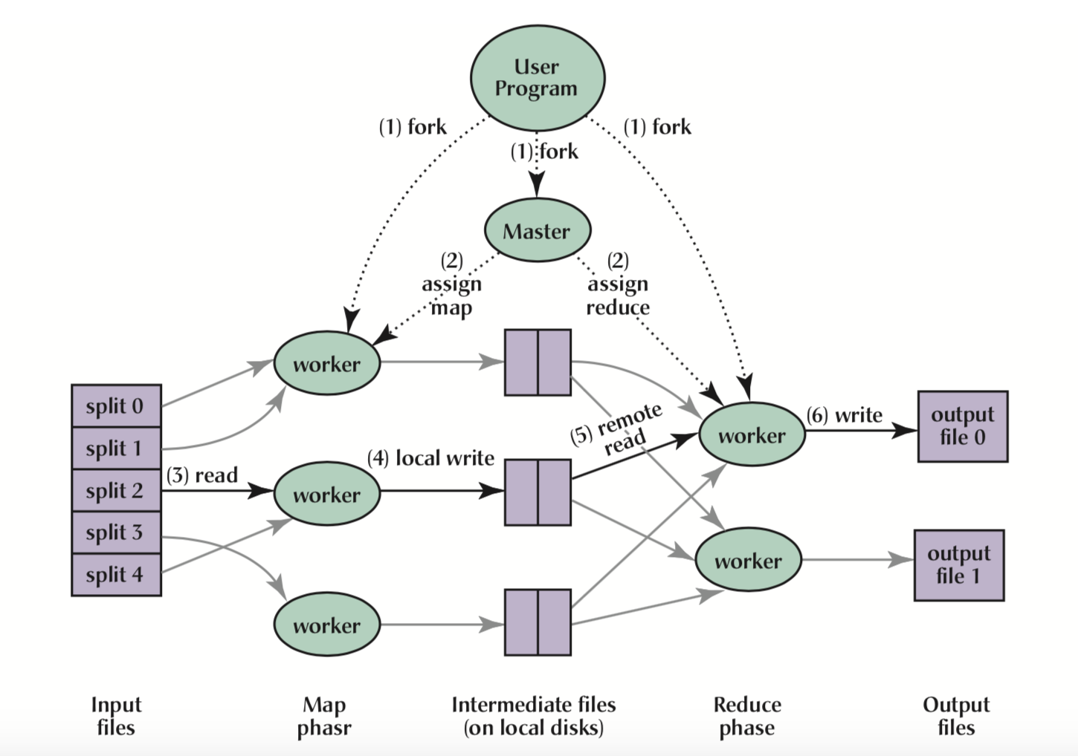
Shuffle Time!
Hadoop sorts the key-value pairs by key and it “shuffles” all pairs with the same key to the same Reducer.

Slide 16
Hadoop’s Role
Makes sure that MapReduce jobs run successfully
Breaks down submitted jobs into map and reduce tasks
Schedules running of tasks based on available resources
Decides where to send tasks in the cluster (closer to the data as much as possible to reduce the network latency)
Monitors each task for success/failure
Restarts failed tasks

Slide 17
What’s in a MapReduce Job?
A unit of work to be performed
A job consists of input data, MapReduce program and configuration information
Hadoop divides a job into a number of tasks
Map tasks
Reduce tasks
Tasks are scheduled using YARN and run on nodes in the cluster.
A failed task will be automatically rescheduled to run on a different node

Slide 18
Wait … What is YARN?

Slide 19
Execution overview
MapReduce Library splits the input files into M pieces of 16 MB to 64 MB
The master picks idle workers and assigns each one a map task or a reduce task
Worker-Parses key/value pairs out of input and passes to user defined Map function
The intermediate key/value pairs produced by the Map function are buffered in memory
Buffered pairs are written to local disk, partitioned into R regions by the partitioning function
Sorts intermediate data by the intermediate keys so that all occurrences of the same key are grouped together
Output of the Reduce function is appended to a final output file
MapReduce call in the user program returns back to the user code

Slide 20

Yet Another Resource Negotiator (YARN)
Also called MR v2
Goal: Splitting up of the functionalities into separate daemons.
Resource management (global resource manager)
Job scheduling/monitoring (per-application Application Manager)
ResourceManager (RM): Arbitrates resources among all the applications in the system. Replaces the Job Tracker in MR v1
NodeManager: Per-machine framework agent. Replaces Task Tracker in MR v1
Responsible for containers, monitoring their resource usage (cpu, memory, disk, network) and reporting the same to the ResourceManager/Scheduler.
Per-application ApplicationMaster (AM): A framework specific library tasked with negotiating resources from the ResourceManager and working with the NodeManager(s) to execute and monitor the tasks.
https://hadoop.apache.org/docs/current/hadoop-yarn/hadoop-yarn-site/YARN.html

Slide 21
Yet Another Resource Negotiator (YARN)
ResourceManger has two main components:
Scheduler: Responsible for allocating resources to the running applications subject to constraints of capacities, queues etc.
It performs no monitoring or tracking of status for the application.
It offers no guarantees about restarting failed tasks either due to application failure or hardware failures.
The Scheduler performs its scheduling function based on the resource requirements of the applications.
Applications Manager: Responsible for accepting job-submissions, negotiating the first container for executing the application specific ApplicationMaster and provides the service for restarting the ApplicationMaster container on failure.
https://hadoop.apache.org/docs/current/hadoop-yarn/hadoop-yarn-site/YARN.html

Slide 22
Yet Another Resource Negotiator (YARN)
https://hadoop.apache.org/docs/current/hadoop-yarn/hadoop-yarn-site/YARN.html

Slide 23
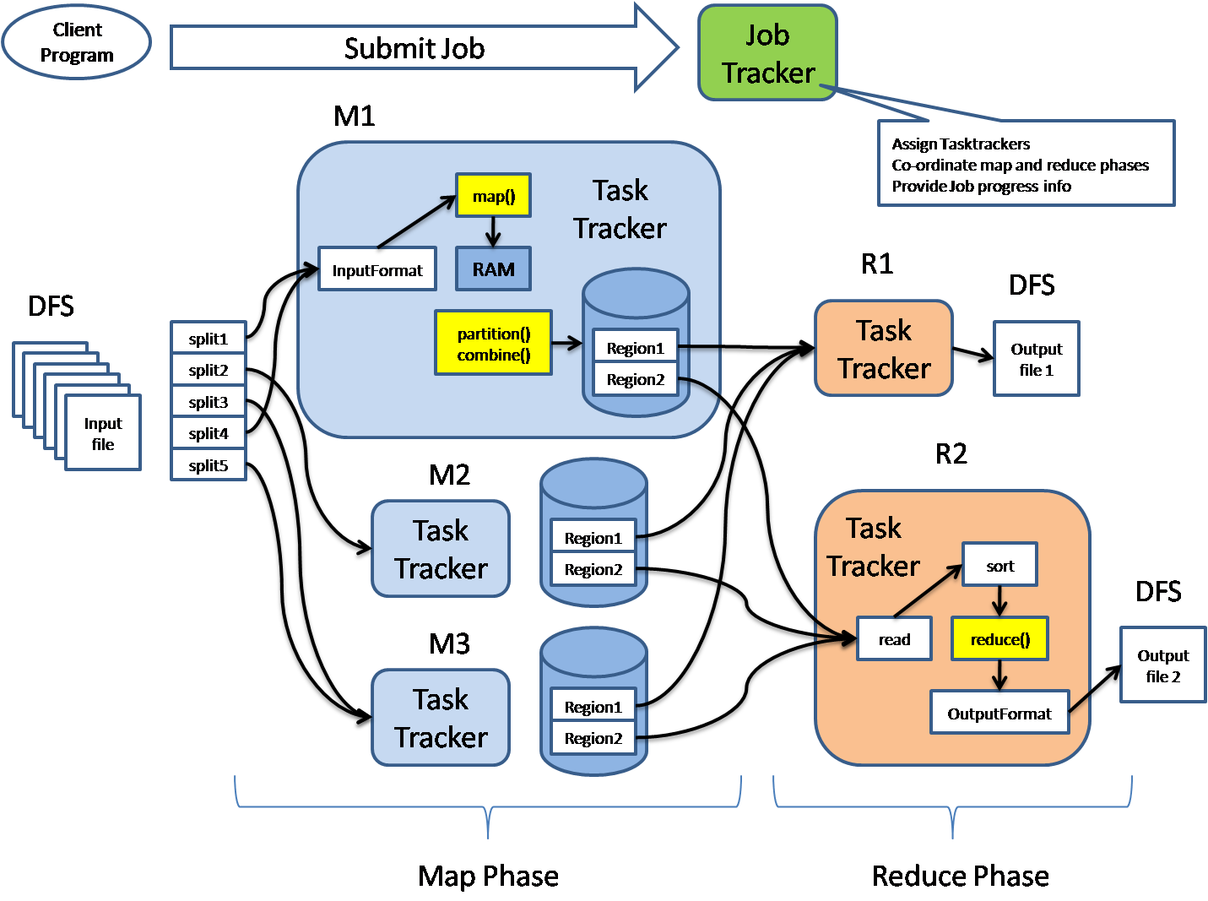
MapReduce Processing Details

Slide 24
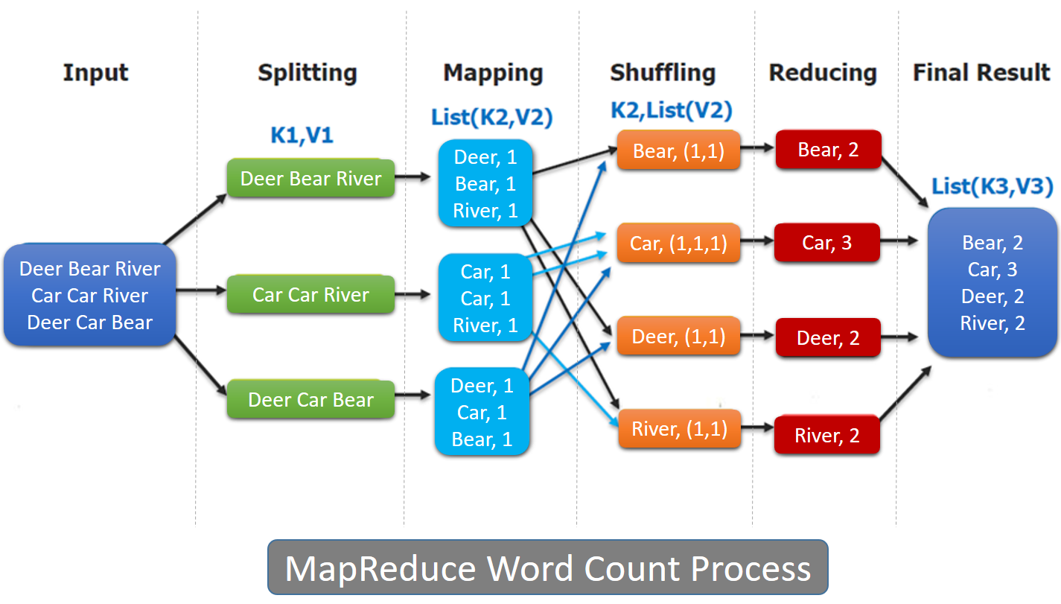
Example: Word Count

Slide 25
Problem of counting the number of occurrences of each word in a large collection of documents : (Example)
map(String key, String value):
// key: document name
// value: document contents
for each word w in value:
EmitIntermediate(w, "1");
reduce(String key, Iterator values):
// key: a word
// values: a list of counts
int result = 0;
for each v in values:
result += ParseInt(v);
Emit(key, AsString(result));
The user writes code to fill in a MapReduce specification object with the names of the input and output files, and optional tuning parameters. The user then invokes the MapReduce function, passing it the specification object. The user’s code is linked together with the MapReduce library
The map function emits each word plus an associated count of occurrences (just ‘1’ in this simple example). The reduce function sums together all counts emitted for a particular word.

Slide 26
Example: X-Ref Indexing
For the cross-reference/indexing example:
The Map function parses each document and emits a sequence of <word, document ID>
The Reduce function accepts all pairs for a given work, sorts the corresponding document ID and emits a <word, list(document ID)>
The set of all output pairs forms the simple answer

Slide 27
Example: Distributed Grep
Grep is very popular command in Unix and Linux
Definition:
The grep filter searches a file for a particular pattern of characters, and displays all lines that contain that pattern. The pattern that is searched in the file is referred to as the regular expression
Grep stands for Globally search for Regular Expression and Print out

Slide 28
Example: Distributed Grep (Cont.)
Distributed Grep
The Map function emits <word, line_number> if word matches search criteria
The reduce function is the identity function that copies the supplied intermediate data to the output

Slide 29
More Examples
Count of URL Access Frequency
The map function processes logs of web page requests and outputs ⟨URL, 1⟩
The reduce function adds together all values for the same URL and emits a ⟨URL, total count⟩ pair.
Reverse Web-Link Graph
The map function outputs ⟨target, source⟩ pairs for each link to a target URL found in a page named source
The reduce function concatenates the list of all source URLs associated with a given target URL and emits the pair: ⟨target, list(source)⟩

Slide 30
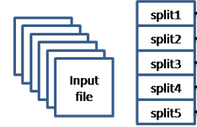
Refinements
Task Granularity (Splitting)
Mapping the task into large set of smaller tasks allows us to benefit as follows:
Minimizes time for fault recovery
Load balancing
Local execution for debugging/testing
Compression of intermediate data

Slide 31
Input Splits
An input for a MapReduce job is divided into fixed-size pieces called input splits.
A map task is created for each split
Runs user-defined map function for each record in the split.
Divide and Conquer
Processing each split is faster than processing the whole input
Splits are processed in parallel

Slide 32
Input Splits
Size Matters
Smaller split size better?
Pro
Better load balance – faster machines will be able to pick up more splits
Con
Overhead of managing the splits and time to create map task
Rule of thumb
Use the size of an HDFS block (128 MB by default)

Slide 33
Fault Tolerance
Worker failure
Workers are periodically pinged by master
NO response = failed worker
If the processor of a worker fails, the tasks of that worker are reassigned to another worker (the Master is in charge)
Master failure
Master writes periodic checkpoints
Another master can be started from the last checkpointed state
If eventually the master dies, the job will be aborted

Slide 34
MapReduce Characteristics
Master-Worker model is used
Sometimes, Master is referred to as Job Tracker and Worker is referred to as Task Tracker
No reduce can begin until map is complete
Master must communicate locations of intermediate files
Tasks scheduled based on location of data

Slide 35
MapReduce Fault Tolerance
Failures:
If Worker fails, Master assigns new Worker
Max number of failures is configurable
Applies to both Map workers and Reduce workers
If map worker fails any time before reduce finishes (losing the intermediate results), the Reduce task must completely rerun

Slide 36
MapReduce
More Readings:
MapReduce: Simplified Data Processing on Large Clusters: https://storage.googleapis.com/pub-tools-public-publication-data/pdf/16cb30b4b92fd4989b8619a61752a2387c6dd474.pdf
Wikipedia: https://en.wikipedia.org/wiki/MapReduce
Hadoop MapReduce Tutorial: https://hadoop.apache.org/docs/current/hadoop-mapreduce-client/hadoop-mapreduce-client-core/MapReduceTutorial.html
https://www.javacodegeeks.com/2012/05/mapreduce-questions-and-answers-part-1.html
https://www.mssqltips.com/sqlservertip/3222/big-data-basics--part-5--introduction-to-mapreduce/
An Overview of Hadoop and MapReduce : https://www.oreilly.com/library/view/programming-hive/9781449326944/ch01.html
YARN Federation: https://hadoop.apache.org/docs/current/hadoop-yarn/hadoop-yarn-site/Federation.html

Slide 37
Python MapReduce Packages
MrJob: https://mrjob.readthedocs.io/en/latest/
Pydoop: http://crs4.github.io/pydoop/
And more ...

Slide 38
Using mrjob
mrjob is a Python package that allows you to write MapReduce jobs in Python and run them on several platforms. It allows:
Write multi-step MapReduce jobs in pure Python
Test on your local machine
Run on a Hadoop cluster
Run in the cloud using Amazon Elastic MapReduce (EMR)
Run in the cloud using Google Cloud Dataproc (Dataproc)
Easily run Spark jobs on EMR or your own Hadoop cluster
Source: https://mrjob.readthedocs.io/en/latest/

Slide 39
Using mrjob
Create a Python class that inherits from MRJob.
The new class contains methods that define the steps (map/reduce) of the MapReduce job
Mapper method
mapper()
Takes a key and a value as parameters
Yields many key-value pairs
Reducer method
reducer ()
Takes a key and an iterator of values
Yields many key-value pairs

Slide 40
MapReduce Exercise
Write a MapReduce job that prints the number of occurrences of each word within a body of text
from mrjob.job import MRJob
import re
WORD_RE = re.compile(r"[\w']+")
class MRWordFreqCount(MRJob):
def mapper(self, _, line):
# Mapper definition here
def reducer(self, word, counts): # Reducer definition here
if __name__ == '__main__':
MRWordFreqCount.run()

Slide 41
Q: Who invented MapReduce?

Slide 42
A: https://www.fiware.org/2014/05/30/mapreduce-was-really-invented-by-julius-caesar/
Q: Who invented MapReduce?

Slide 43

Cloud Computing

Slide 44
What is Cloud Computing
Renting resources
Compute Power
Storage
Networking
Analytics
Only pay for what you use
Cloud Providers (Azure, AWS, GCP) manage the physical hardware and the infrastructure

Slide 45
Benefits of Cloud Computing
Cost-effective – only pay for what you use
No infrastructure cost
No need to maintain own servers, network, storage.
Scalable
Scaling out/Horizontal Scaling
Elasticity
Automatically adding or removing resources based on the workload

Slide 46
Benefits of Cloud Computing
Reliability
Data backup, disaster recovery, data replication
Security
Shared responsibility

Slide 47
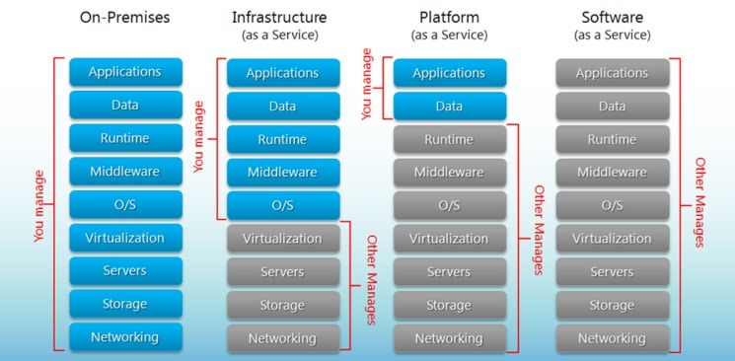
Cloud Service Categories

Slide 48
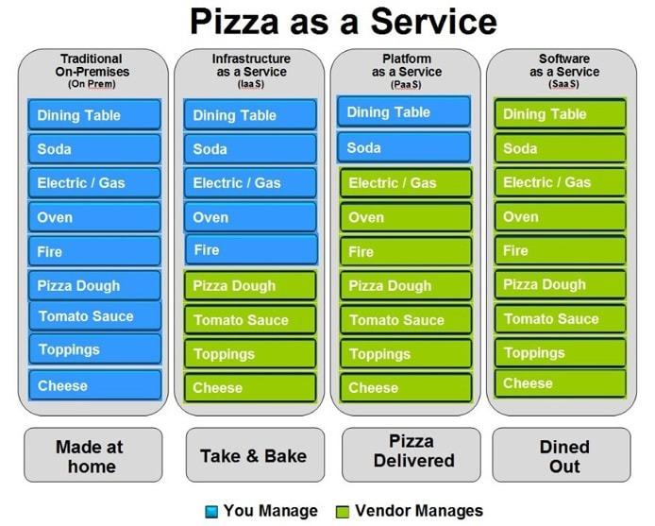
Cloud Service Categories

Slide 49
Cloud Data Analytics Services
Data Warehouse (Azure Synapse, AWS Redshift)
Advanced Analytics (Databricks, HDInsight, AWS EMR)
Data Integration Service (Azure Data Factory)
Machine Learning (Azure ML, AWS Sage Maker)
Storage (Azure Data Lake, AWS S3)

Slide 50

Data Lake

Slide 51
Data Lake
A data lake is a system or repository of data stored in its natural/raw format,^{[1]} usually object blobs or files. A data lake is usually a single store of data including raw copies of source system data, sensor data, social data etc.,^{[2]} and transformed data used for tasks such as reporting, visualization, advanced analytics and machine learning. A data lake can include structured data from relational databases (rows and columns), semi-structured data (CSV, logs, XML, JSON), unstructured data (emails, documents, PDFs) and binary data (images, audio, video).^{[3]} A data lake can be established "on premises" (within an organization's data centers) or "in the cloud" (using cloud services from vendors such as Amazon, Microsoft, or Google).
A data swamp is a deteriorated and unmanaged data lake that is either inaccessible to its intended users or is providing little value.^{[4]}
https://en.wikipedia.org/wiki/Data_lake

Slide 52
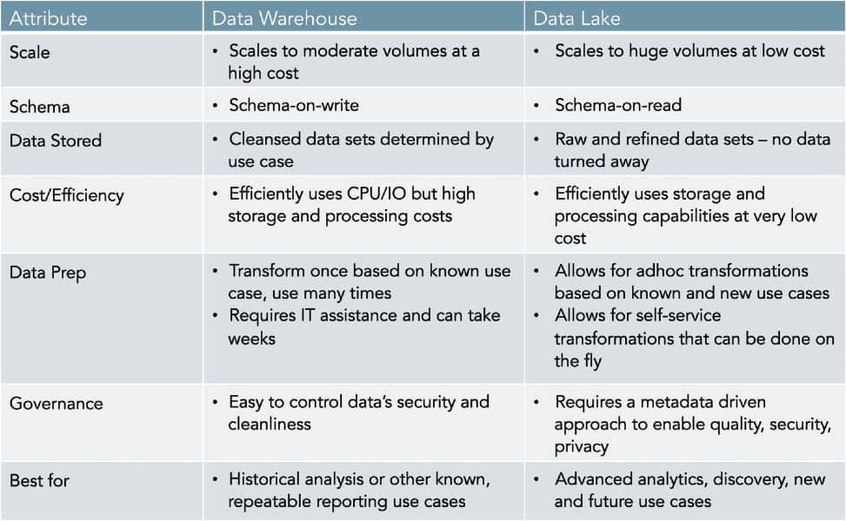
Data Lake vs. Data Warehouse
https://www.zaloni.com/resources/blog/why-smart-companies-are-complementing-their-data-warehouses-with-data-lakes/

Slide 53
Homework
THIS HOMEWORK IS HARDER THAN PREVIOUS ONES. Start working early and ask questions often
Download yelp.csv from Kaggle

Slide 54
Homework
Write three Python scripts using mrjob that tell me:
Average number of words in each review (define “words” however you like but be explicit about it)
Count of reviews by year-month (eg “2021-09”)
Average rating of any review marked ”cool” (eg where cool != 0)

Slide 55
Homework
Bonus (2 points): run the homework on Amazon EMR
Submission: same as before
Filenames should be homework/hw03-[1|2|3].[py|ipynb]
Bonus should be the file controller from EMR Console

Slide 56
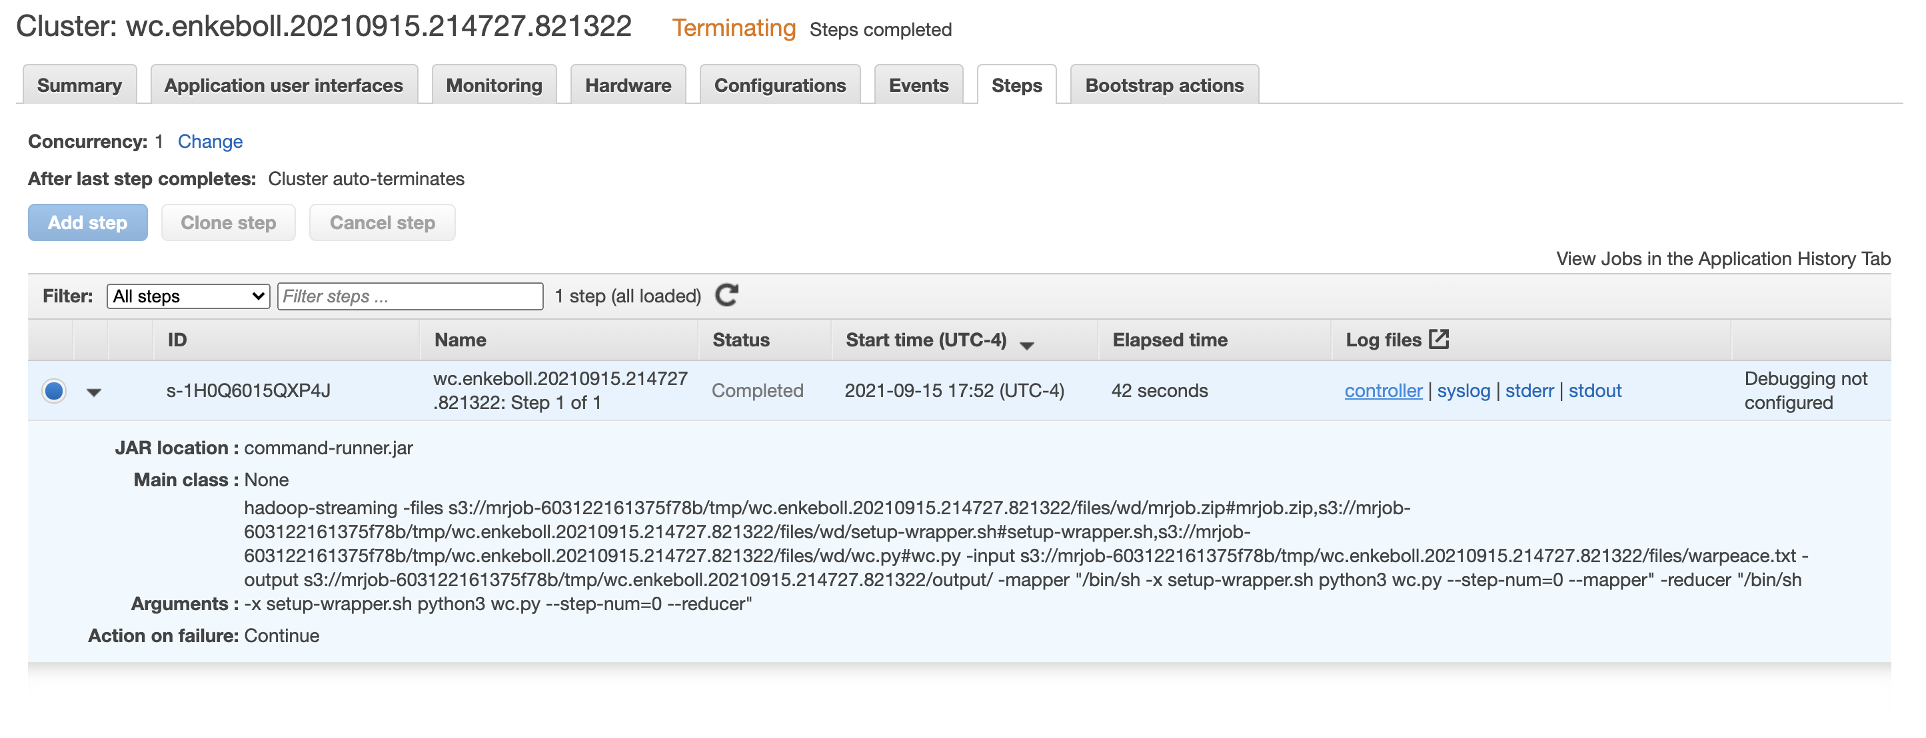


Homework (Bonus)

Slide 57

Questions

